Slide 1
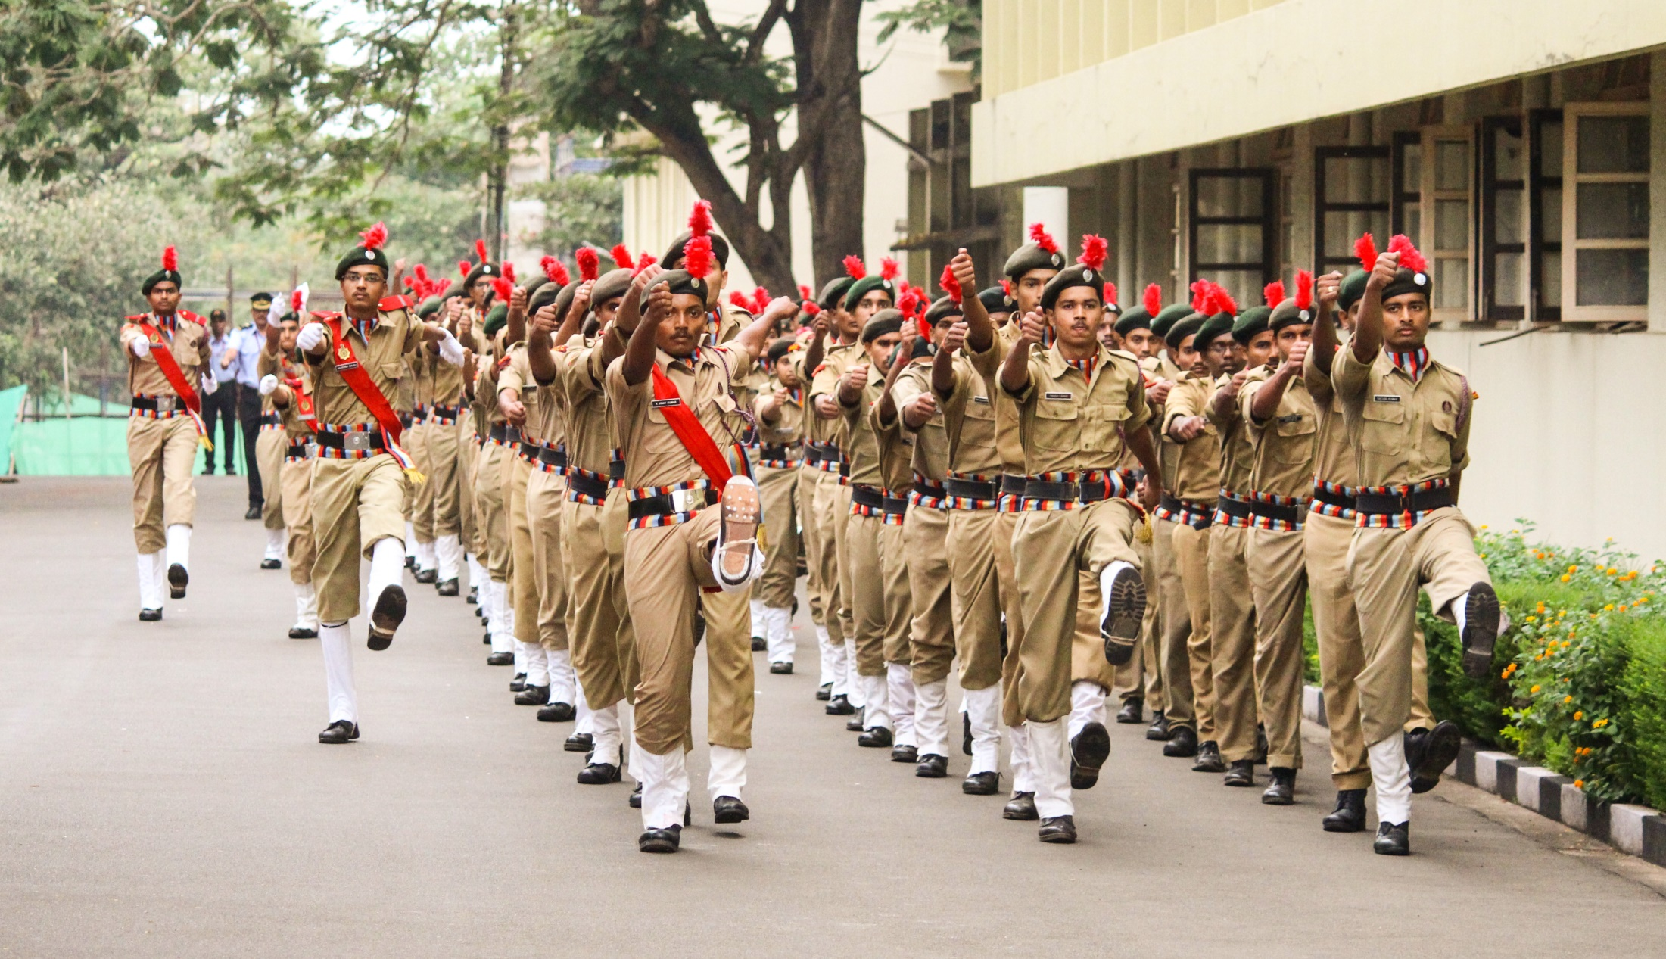

NATIONAL CADET CORPS
UNITY AND DISCIPLINE
NITK SURATHKAL

Slide 2
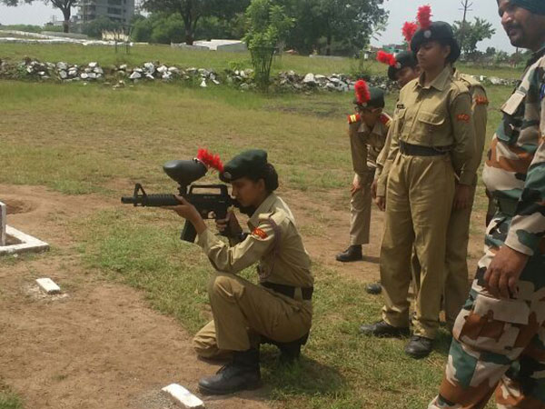
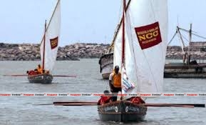
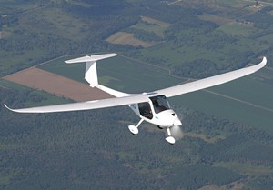
NATIONAL CADET CORPS
INDIAN MILITARY CADET CORPS WITH HQ AT NEW DELHI.
OPEN TO SCHOOL & COLLEGE STUDENTS ON VOLUNTARY BASIS.
TRI-SERVICES ORGANIZATION: ARMY, NAVY & AIR FORCE.

Slide 3
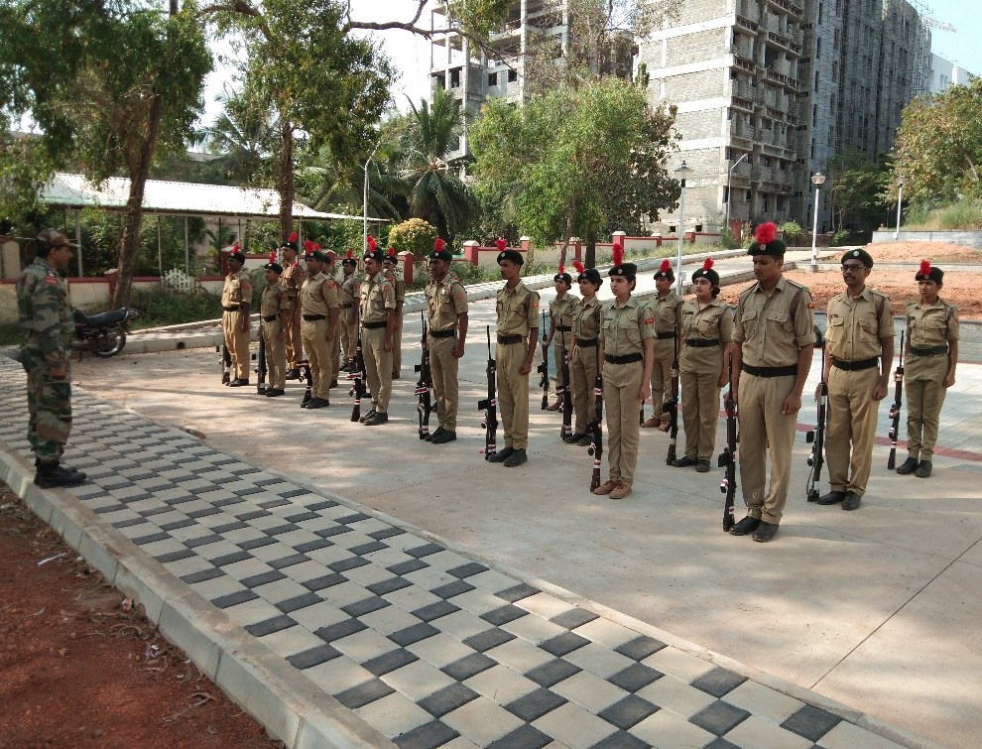
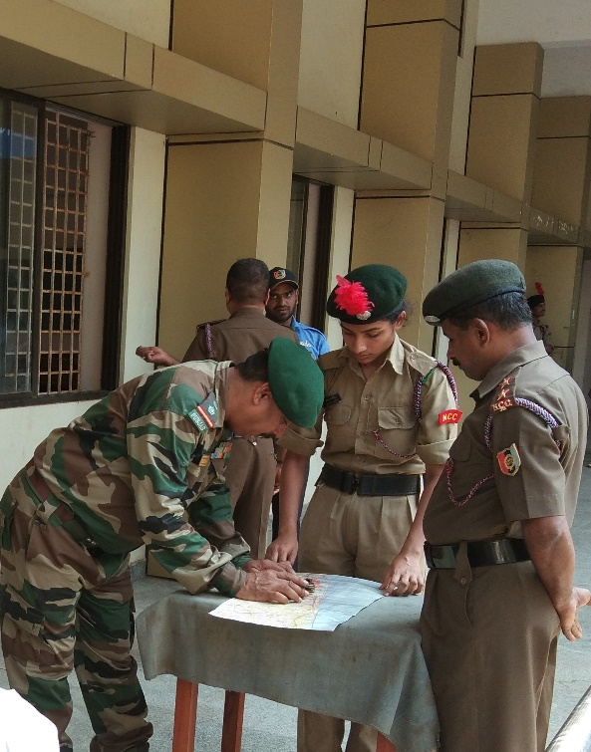
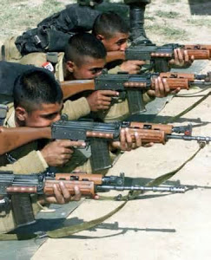
NATIONAL CADET CORPS
ENGAGED IN GROOMING YOUTH OF THE COUNTRY INTO DISCIPLINED AND PATRIOTIC CITIZENS.
CADETS ARE GIVEN BASIC MILITARY TRAINING.

Slide 4
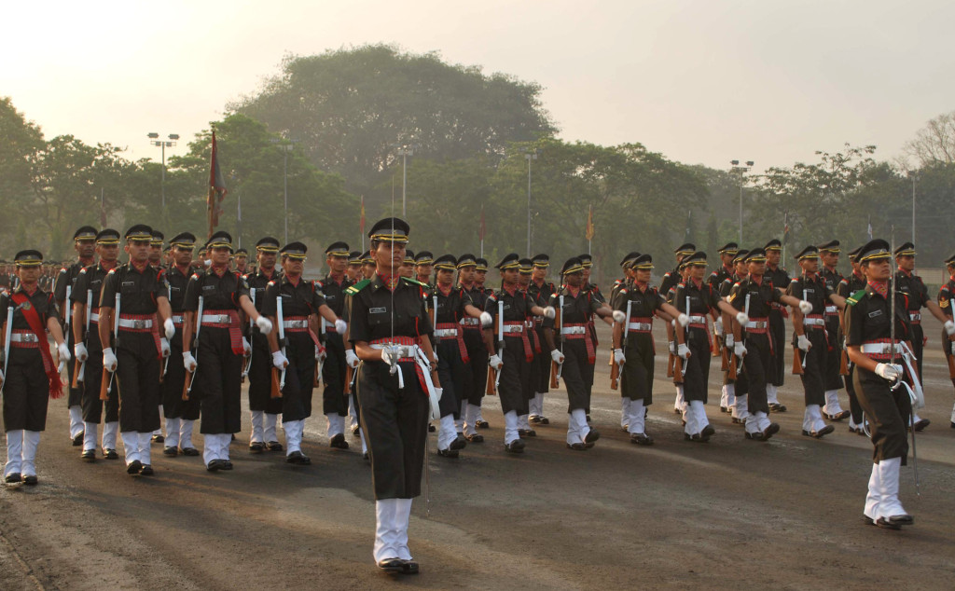
NATIONAL CADET CORPS
NO LIABILITY FOR ACTIVE MILITARY SERVICE ONCE THEY COMPLETE THEIR COURSE.
GIVEN PREFERENCE OVER OTHER CANDIDATES DURING SELECTIONS BASED ON ACHIEVEMENTS IN THE CORPS.

Slide 5
NATIONAL CADET CORPS
EVOLUTION

Slide 6
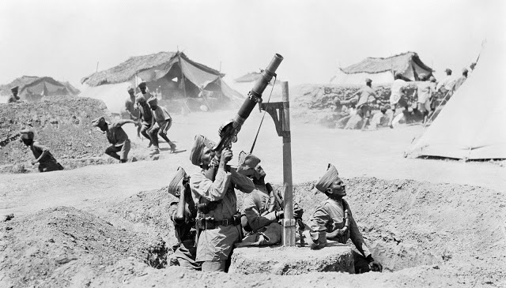
1917: WW I ERA
UNIVERSITY CORPS RAISED UNDER DEFENCE ACT TO MAKE UP SHORTAGE OF THE ARMY

Slide 7
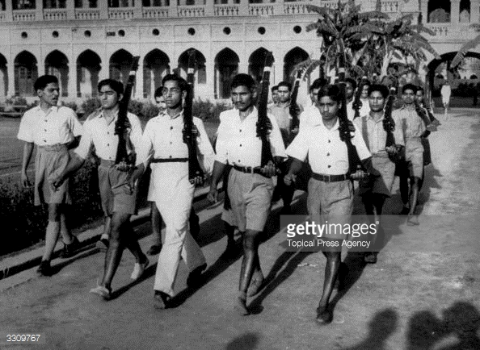
POST WW II
UNIVERSITY TRAINING CORPS

Slide 8
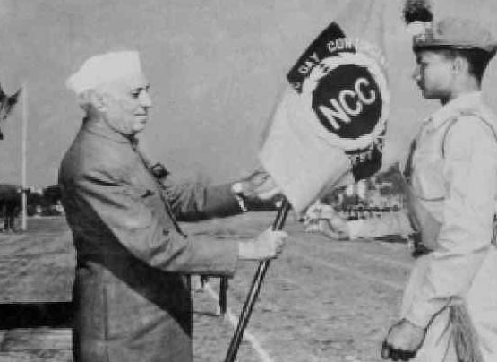
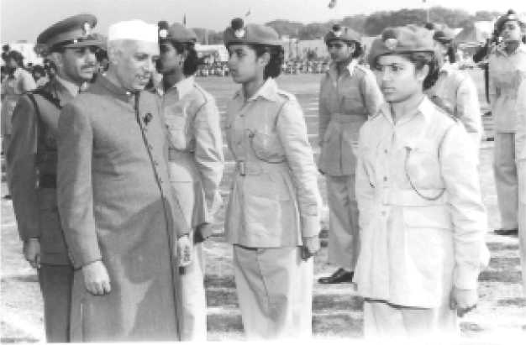
1948: POST-INDEPENDENCE
NCC ACT PASSED BY A BILL OF PARLIAMENT
20,000 CADETS ENROLLED
GIRL CADETS INDUCTED

Slide 9
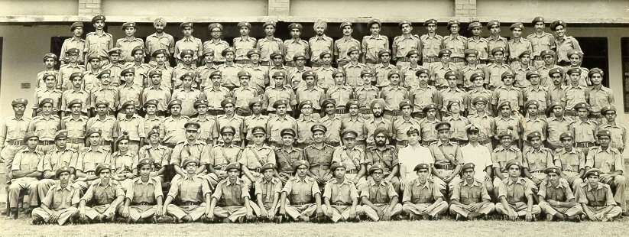
1963: POST SINO-INDIA WAR
NCC TRAINING WAS MADE COMPULSORY FOR ALL MALE UNDERGRADUATES

Slide 10
1965-71
1968: TRAINING MADE VOLUNTARY.
1965 & 1971 WARS: NCC CADETS WERE THE SECOND LINE OF DEFENCE.
- CONSTRUCTED BUNDHS.
- ORGANIZED CAMPS TO ASSIST ORDNANCE FACTORIES.
- SUPPLIED ARMS AND AMMUNITION TO THE FRONT.
- PATROLLED REAR AREAS TO CAPTURE ENEMY PARATROOPERS.
- WORKED WITH CIVIL DEFENCE IN RESCUE WORKS, FIRE FIGHTING AND TRAFFIC CONTROL.

Slide 11
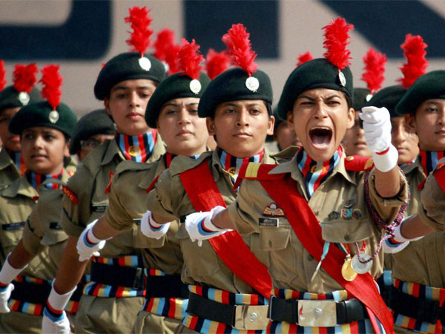
NCC TODAY
13,00,000 CADETS
LARGEST UNIFORMED YOUTH ORGANISATION IN THE WORLD

Slide 12
UNITY AND DISCIPLINE
2 KAR ENGR COY NCC, SURATHKAL

Slide 13
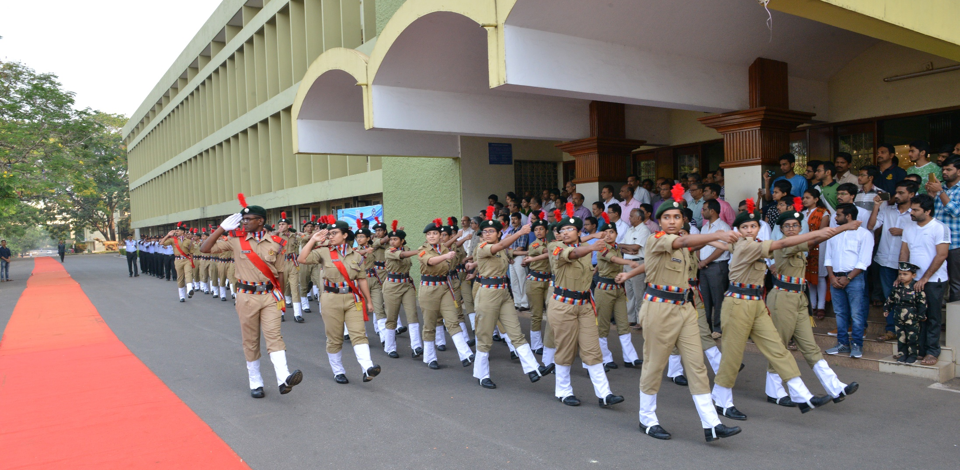
2 KAR ENGR COY NCC
1964: RAISED AS 4 MYSORE ENGR REGT NCC - THREE COYS OF 600 CDTS.
1973: RENAMED 2 KAR ENGR COY NCC WITH 200 CDTS.

Slide 14
STAFF
CO
ASSOCIATE NCC OFFICERS
LT (DR) P SAM JOHNSON
LT (DR) SHIVANANDA NAYAK
INSTRUCTORS
(MADRAS ENGINEERING GROUP)
FIVE INSTRUCTORS

Slide 15
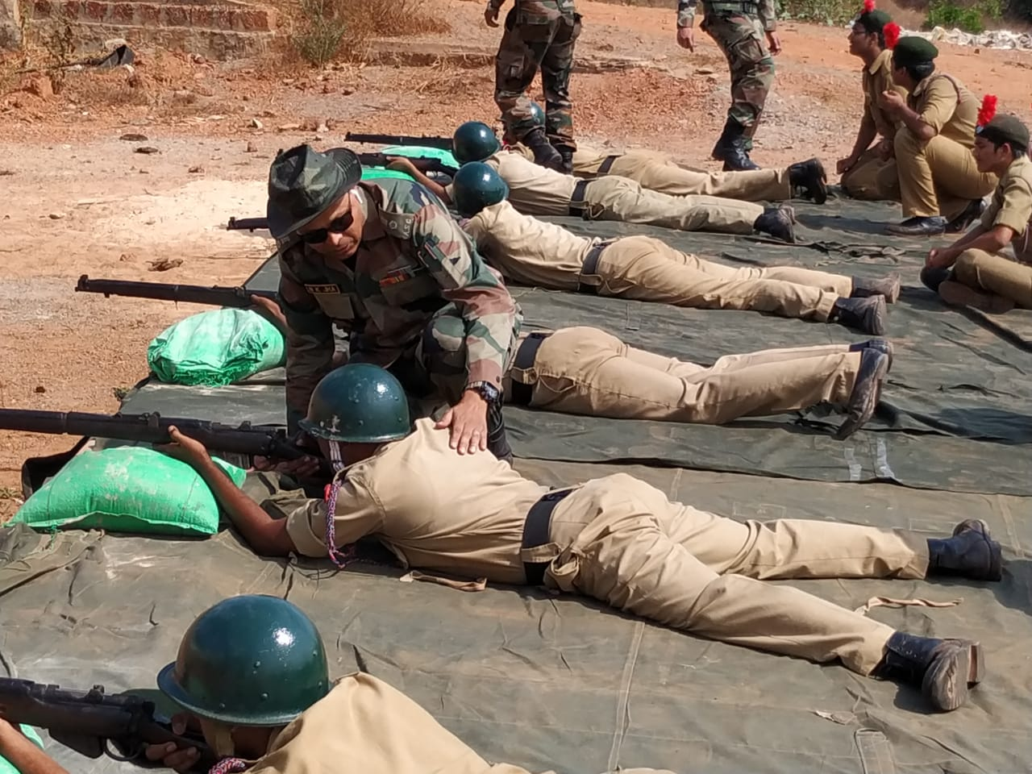
NCC TRAINING
NOT EXTRA-CURRICULAR - CO-CURRICULAR.

Slide 16
VISION OF NITK
TO FACILITATE TRANSFORMATION OF STUDENTS INTO GOOD HUMAN BEINGS, RESPONSIBLE CITIZENS & COMPETENT PROFESSIONALS, FOCUSSING ON ASSIMILATION, GENERATION & DISSEMINATION OF KNOWLEDGE
AIMS OF NCC
DEVELOP CHARACTER, COMRADESHIP, DISCIPLINE, LEADERSHIP, SECULAR OUTLOOK, IDEALS OF SELFLESS SERVICE & SPIRIT OF ADVENTURE AMONGST THE YOUTH.
CREATE A HUMAN RESOURCE OF ORGANISED, TRAINED & MOTIVATED YOUTH, TO PROVIDE LEADERSHIP IN ALL WALKS OF LIFE AND ALWAYS AVAILABLE FOR THE SERVICE OF THE NATION.
TO PROVIDE A SUITABLE ENVIRONMENT TO MOTIVATE THE YOUTH TO TAKE UP A CAREER IN THE ARMED FORCES.

Slide 17
VISION OF NITK
AIMS OF NCC
GOOD & WORTHY
HUMAN BEINGS
CHARACTER
DISCIPLINE
COMRADESHIP
LEADERSHIP
SPIRIT OF ADVENTURE
RESPONSIBLE CITIZENS
IDEALS OF SELFLESS SERVICE
SECULAR OUTLOOK
COMPETENT PROFESSIONALS
ORGANISATION
TRAINING
MOTIVATION

Slide 18
BENEFITS OF NCC

Slide 19
BENEFITS OF NCC
CENTRAL GOVT

Slide 20
CONCESSION IN EMPLOYMENT
SER | RESERVED VACANCIES | REMARKS
1. | Commission: Defence Forces Training Academies | (a) Army 64/ year: IMA, Dehradun for NCC ‘C’ Certificate through UPSC and SSB Interview.
 |  | (b) 100/ year – OTA, Chennai for Short Service Commission. No UPSC Exam only SSB.
 |  | (c) Navy – 6/ Course. No UPSC Exam only Naval SSB.
 |  | (d) IAF – 10% in all courses including Flying courses. No UPSC exam, only Air Force SSB.

Slide 21
FINANCIAL BENEFITS
EXPENDITURE ON NCC TRAINING BORNE BY THE GOVT.
- UNIFORM.
- CAMPS EXPENSES (TRANSPORTATION TO TRAINING AREAS, ACCOMMODATION AND MEALS)
- PARADES.
- REFRESHMENTS DURING PARADES.
- ADVENTURE SPORTS FOR VOLUNTEERS.
FINANCIAL ASSISTANCE TO DESERVING CADETS.
CASH PRIZES & AWARDS TO OUTSTANDING CADETS. SCHOLARSHIPS TO ACADEMICALLY BRILLIANT STUDENTS.

Slide 22
BENEFITS OF NCC
STATE GOVT

Slide 23
INCENTIVES BY STATES
ACADEMIC FIELD | EMPLOYMENT FIELD
SEATS RESERVED/ BONUS MARKS IN GOVT PG DEGREE COURSES FOR NCC ‘B’ & ‘C’ CERTIFICATE HOLDERS . SCHOLARSHIPS AND CASH PRIZES TO OUTSTANDING CADETS. | SEATS RESERVED/ PREFERENCE GIVEN TO NCC ‘B’ & ‘C’ CERTIFICATE HOLDERS IN GOVT DEPARTMENTS.

Slide 24
STUDENTS EXPECTATIONS FROM NCC
GROOMING/ PERSONALITY DEVELOPMENT.
SENSE OF DIGNITY AND PRIDE.
SOCIAL SKILLS AND COMMUNICATION.
TRAINING & ADVENTURE ACTIVITIES.
EDGE DURING PLACEMENTS.

Slide 25
CORE LIFE SKILLS (W.H.O.)
SELF AWARENESS.
EMPATHY.
CRITICAL THINKING.
CREATIVE THINKING.
DECISION MAKING.
PROBLEM SOLVING.
EFFECTIVE COMMUNICATION.
INTER-PERSONAL RELATIONSHIPS.
COPING WITH STRESS & EMOTIONS.

Slide 26
NCC ACTIVITIES

Slide 27
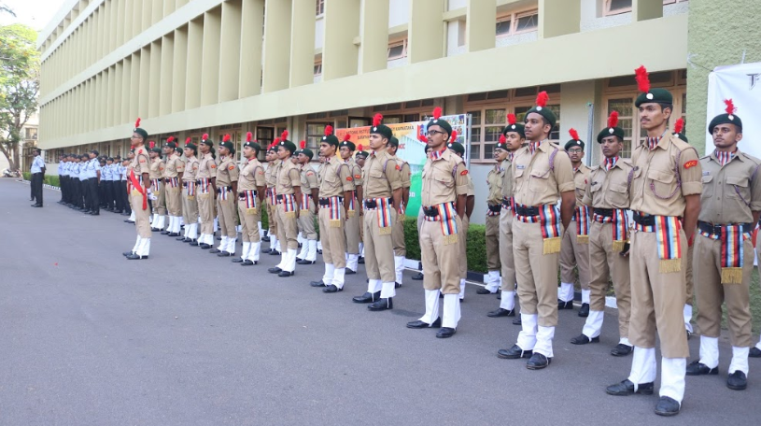
TRAINING PARADES

Slide 28
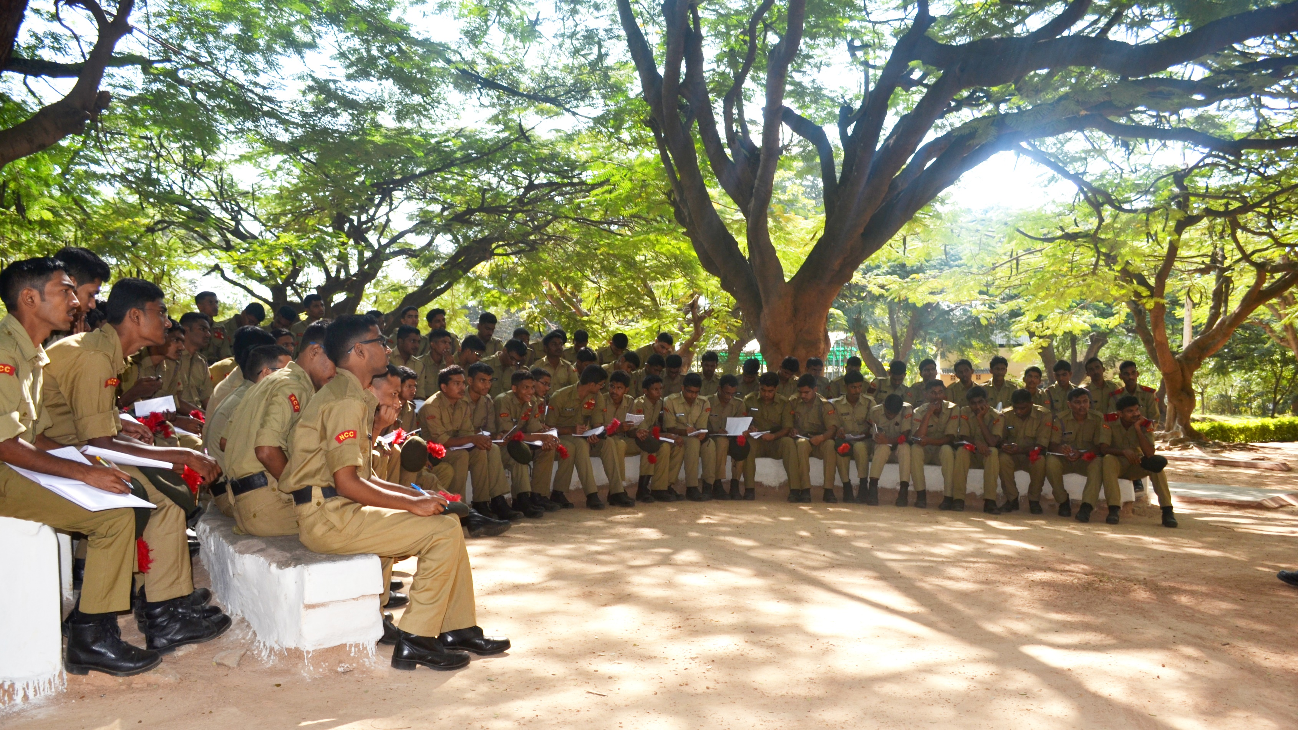
TRAINING PARADES

Slide 29
SCHEDULE
FIRST YEAR : 15 PARADES.
SECOND YEAR: 18 PARADES & ONE CAMP (‘B’CERTIFICATE).
THIRD YEAR : 18 PARADES & ONE CAMP (‘C’ CERTIFICATE).
75 % ATTENDANCE AND ONE CAMP MANDATORY
FOR APPEARING IN EXAMS

Slide 30
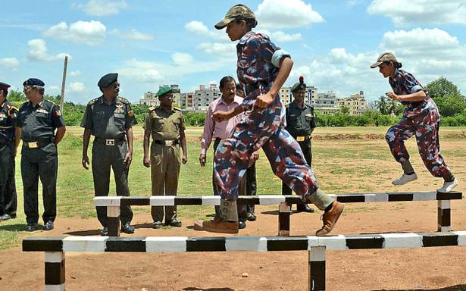
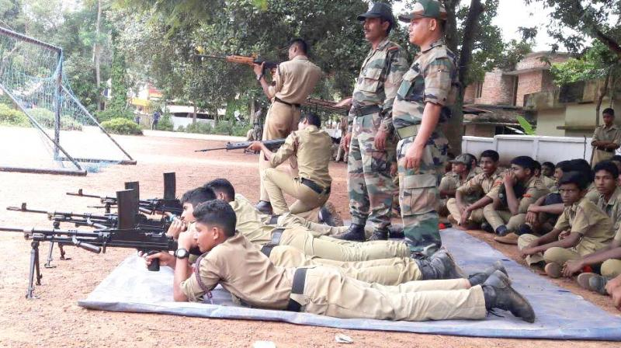
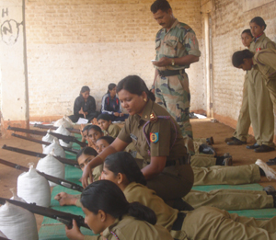
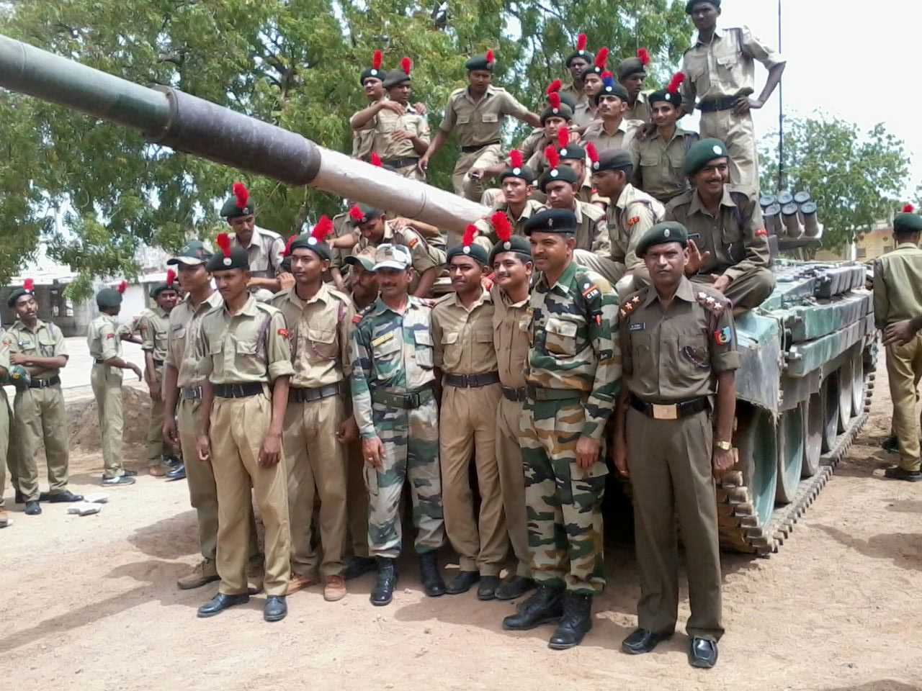
CAMPS INCLUDING
ARMY ATTACHMENT

Slide 31
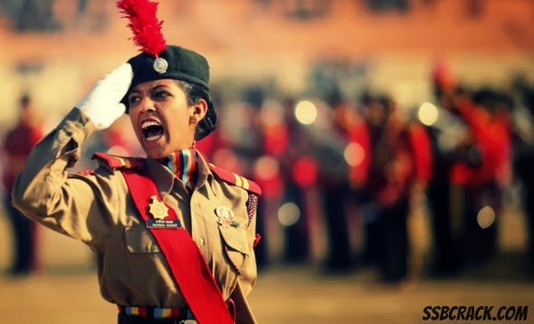
BUILD CHARACTER
INFUSING CONFIDENCE

Slide 32
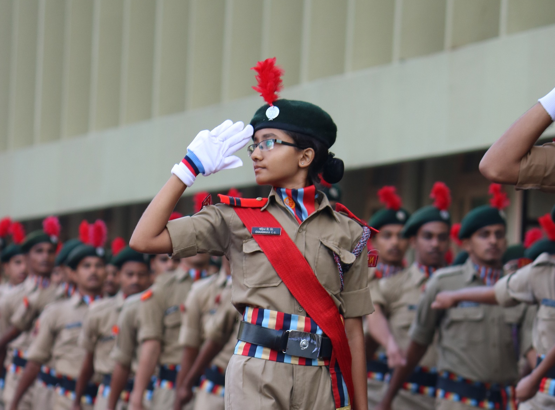
GROOM LEADERSHIP
PROVIDING OPPORTUNITIES

Slide 33
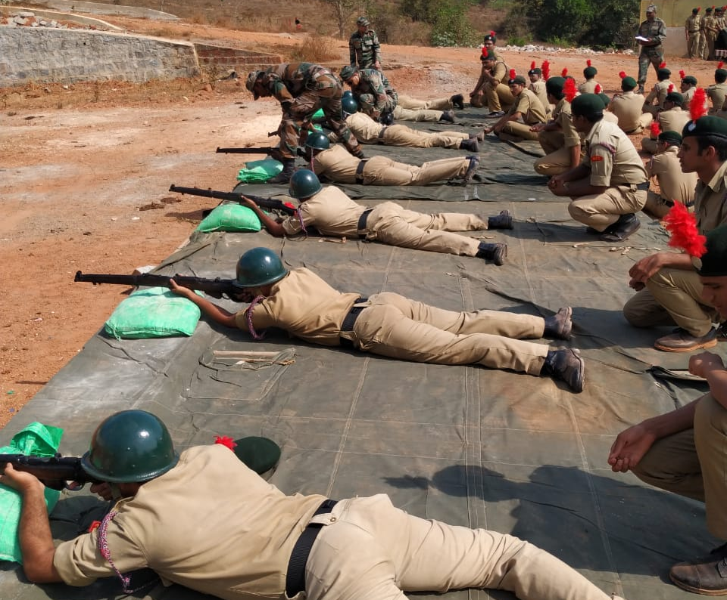
INSTIL DISCIPLINE
BASIC MILITARY TRAINING

Slide 34
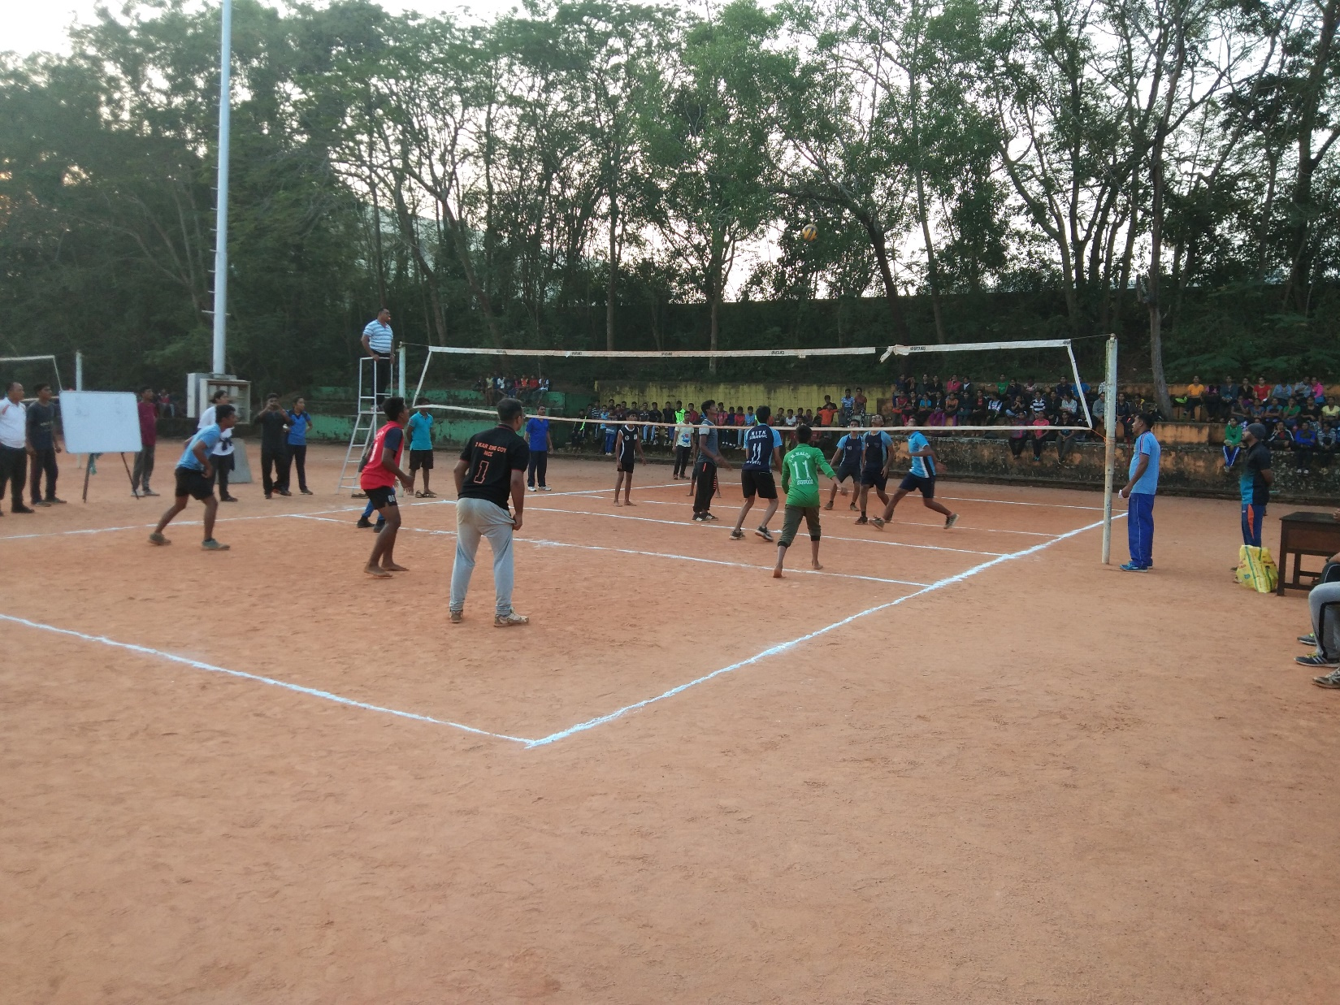
FOSTER COMRADESHIP & PROMOTE SECULAR OUTLOOK
ENCOURAGING TEAMWORK

Slide 35
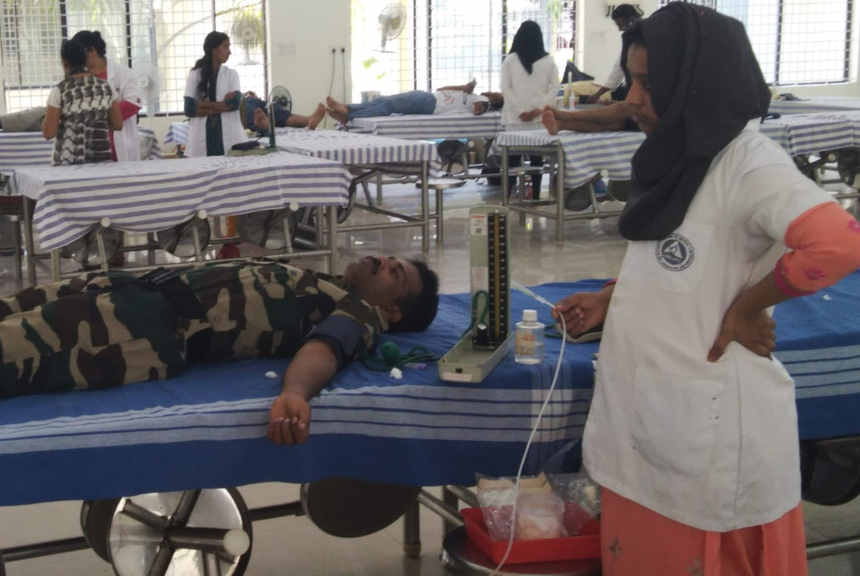
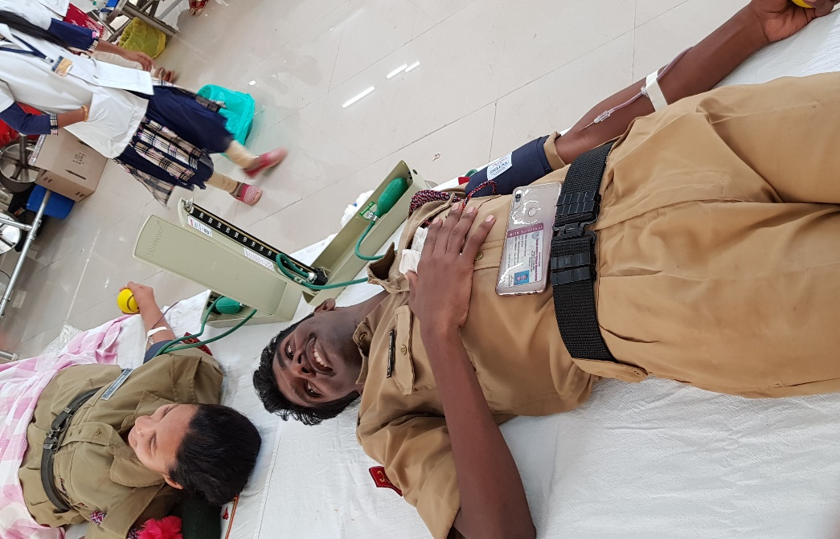
ENCOURAGE SELFLESS SERVICE
COMMUNITY SERVICE DRIVES

Slide 36
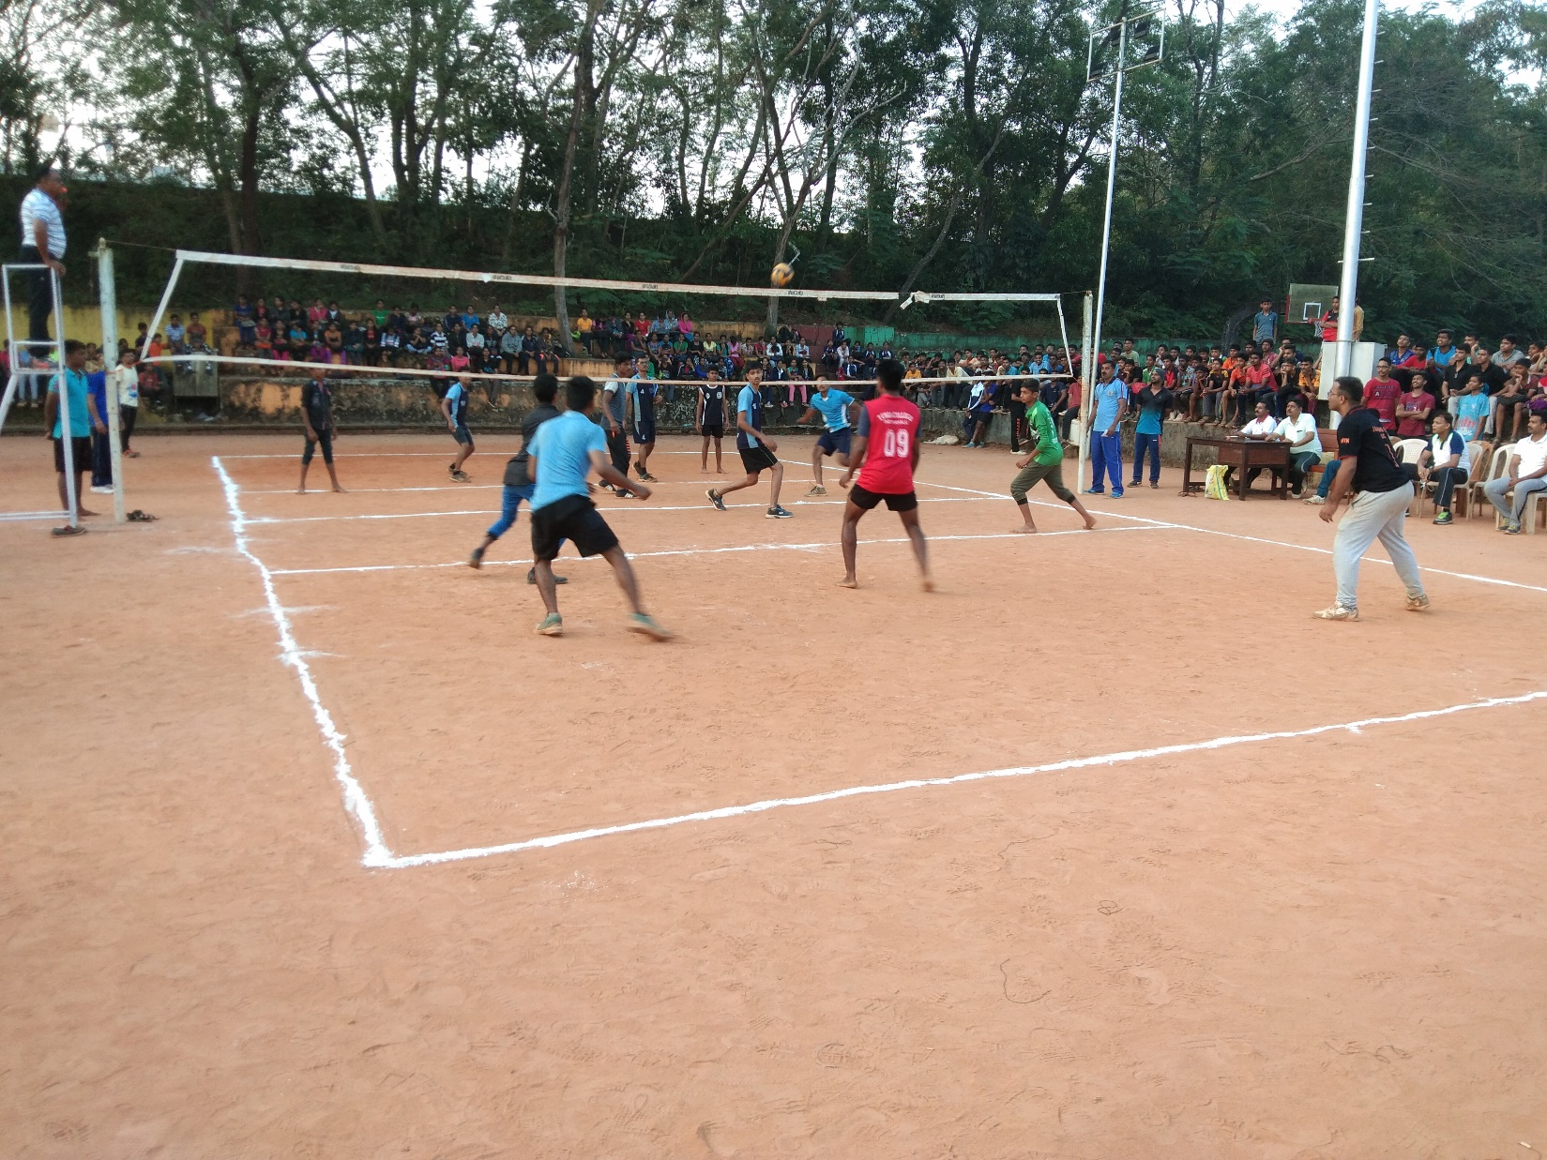
KINDLE SPIRIT OF ADVENTURE
OUTDOOR ACTIVITIES

Slide 37
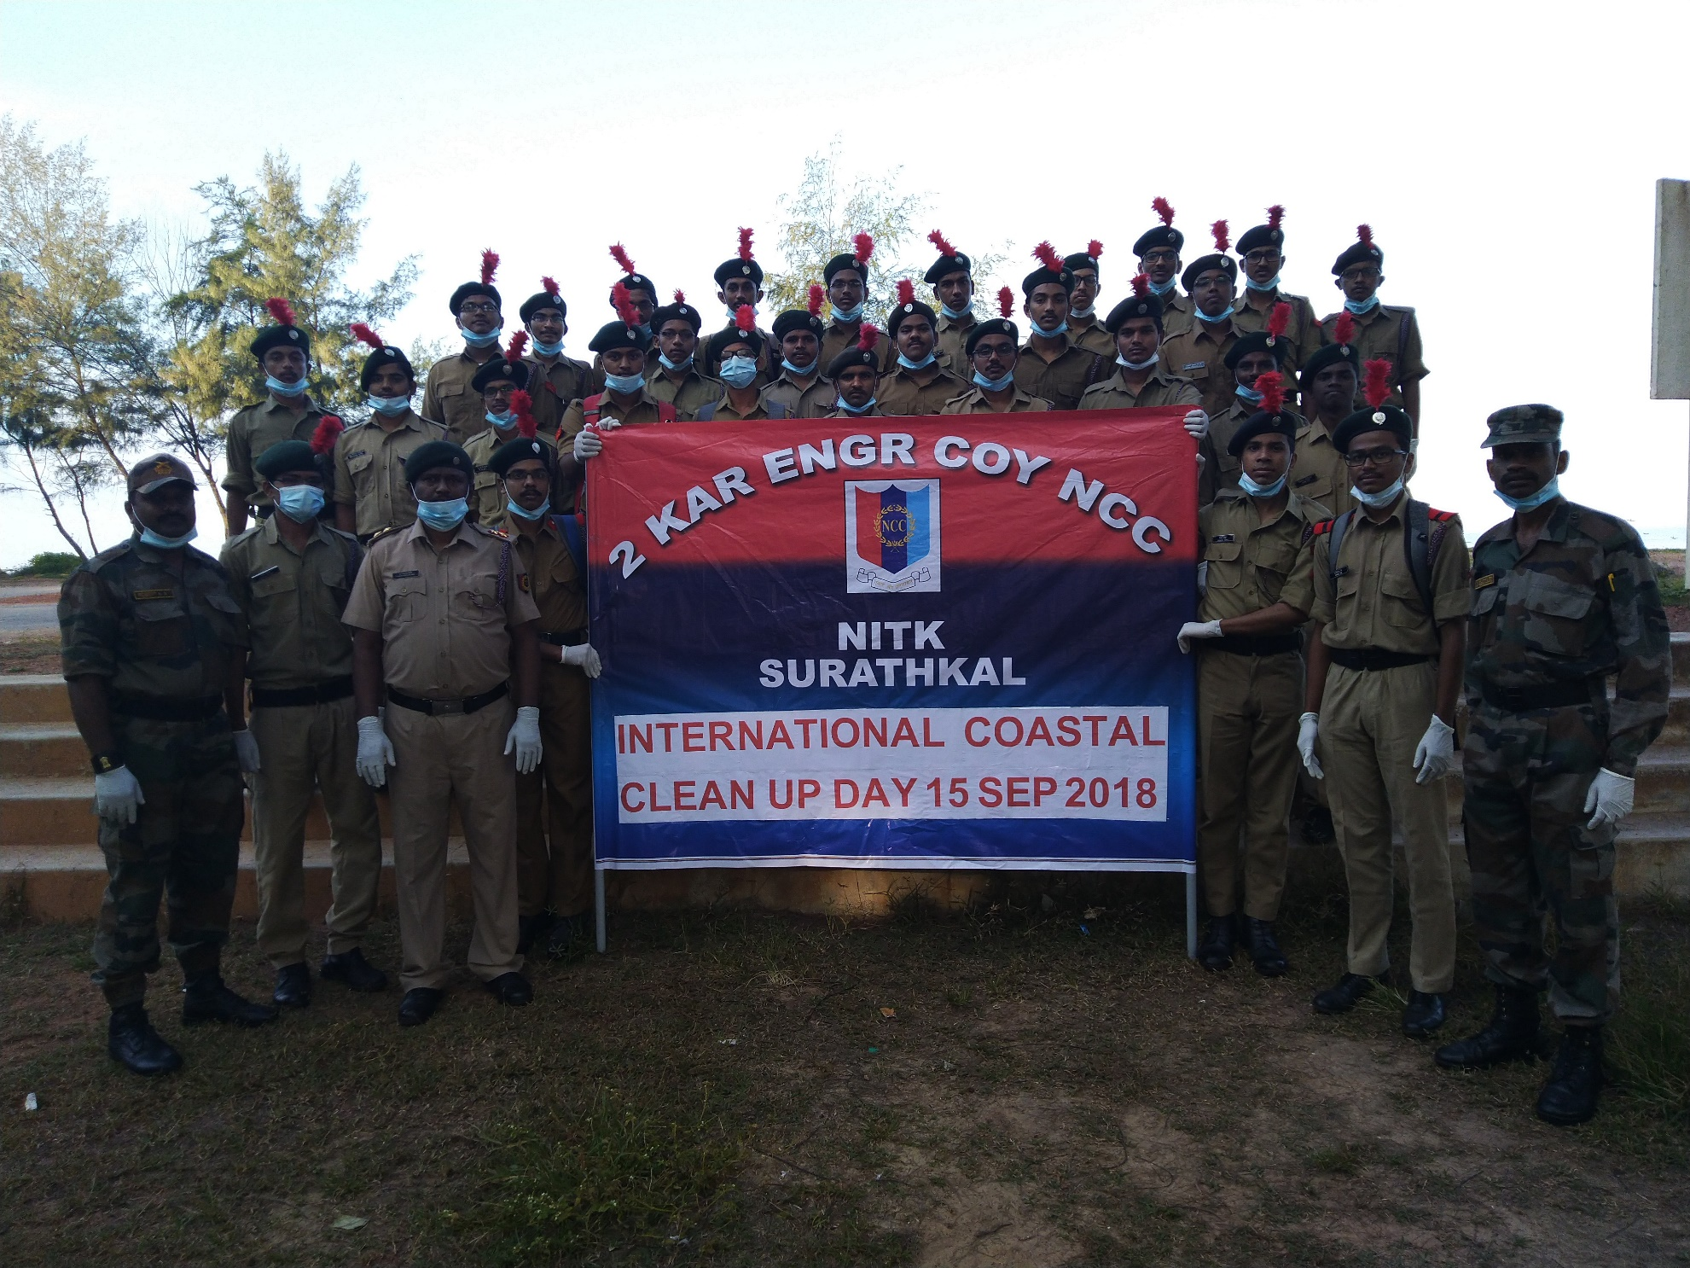
INCLUDING VOLUNTEER ACTIVITIES

Slide 38
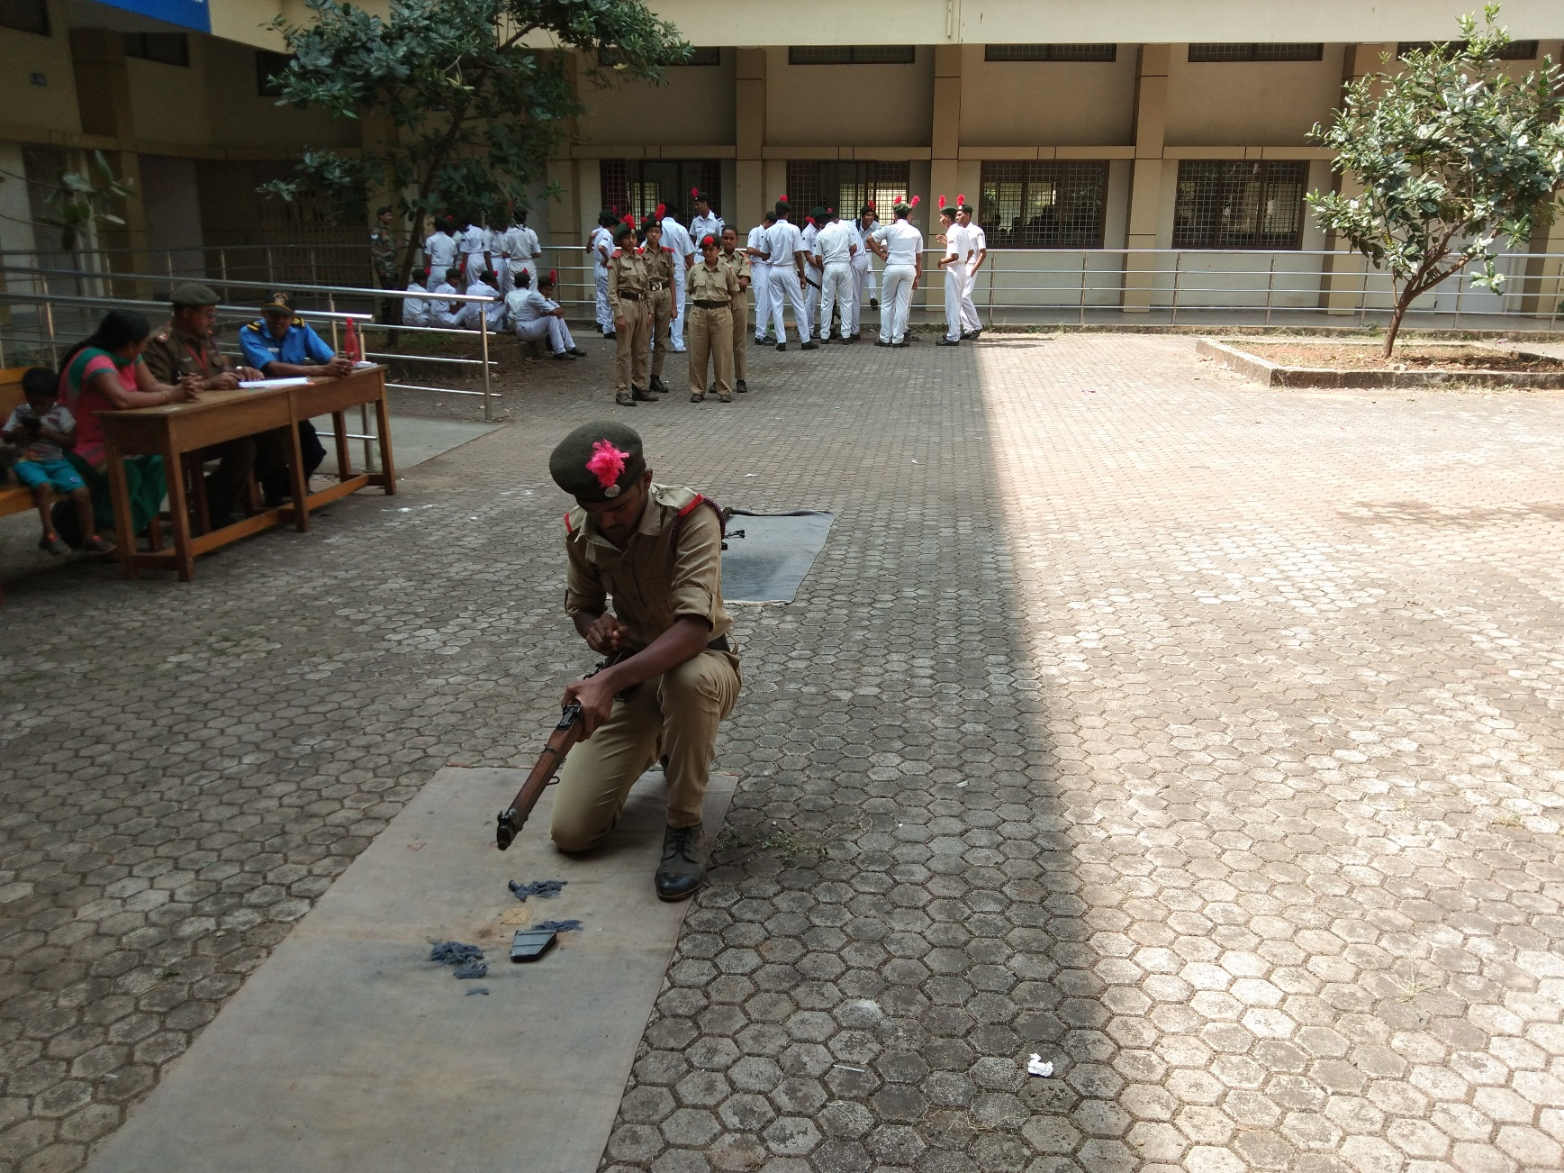
NURTURE ORGANISATION SKILLS
ENCOURAGING GROUP TASKS

Slide 39
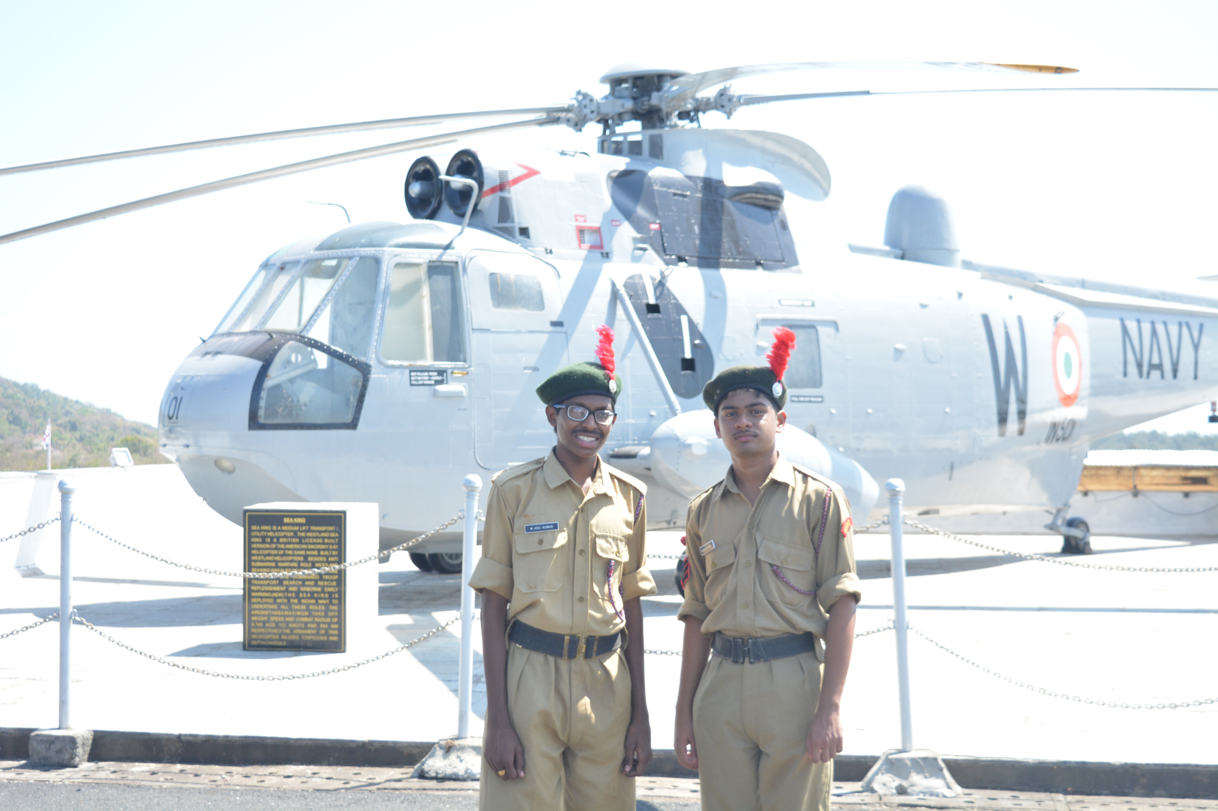
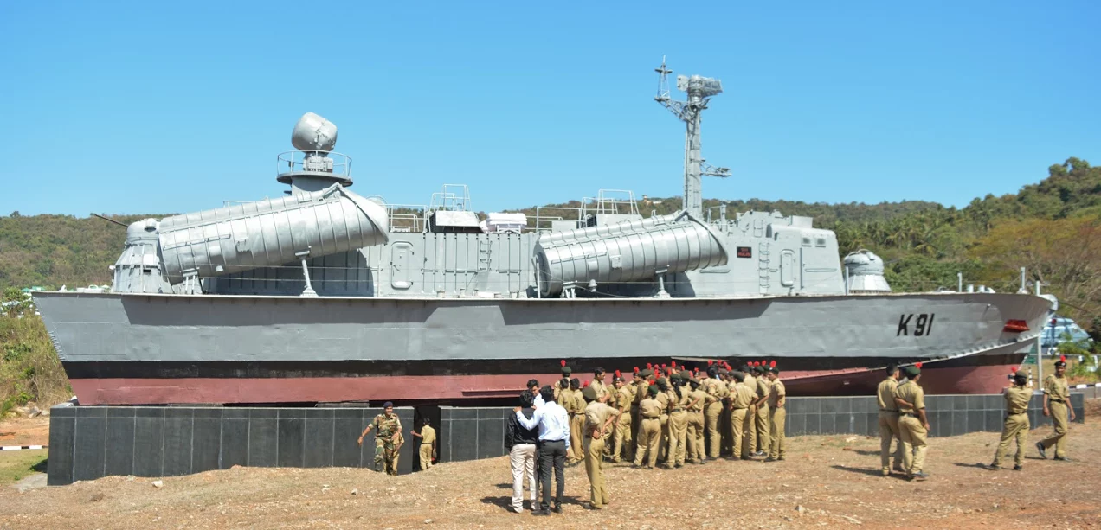
PROVIDE MOTIVATATION
VISITS TO MILITARY ACADEMIES

Slide 40
ROUTINE
PARADES ONLY ON SATURDAYS.
ACADEMIC SCHEDULE (INCL EXAMS) CONSIDERED.
TIMINGS: 0830H – 1300H.
NO ABSENT MARKED FOR NCC ACTIVITIES.

Slide 41
VACANCIES AVAILABLE
65: 35 VACANCIES RESERVED FOR GIRLS.

Slide 42
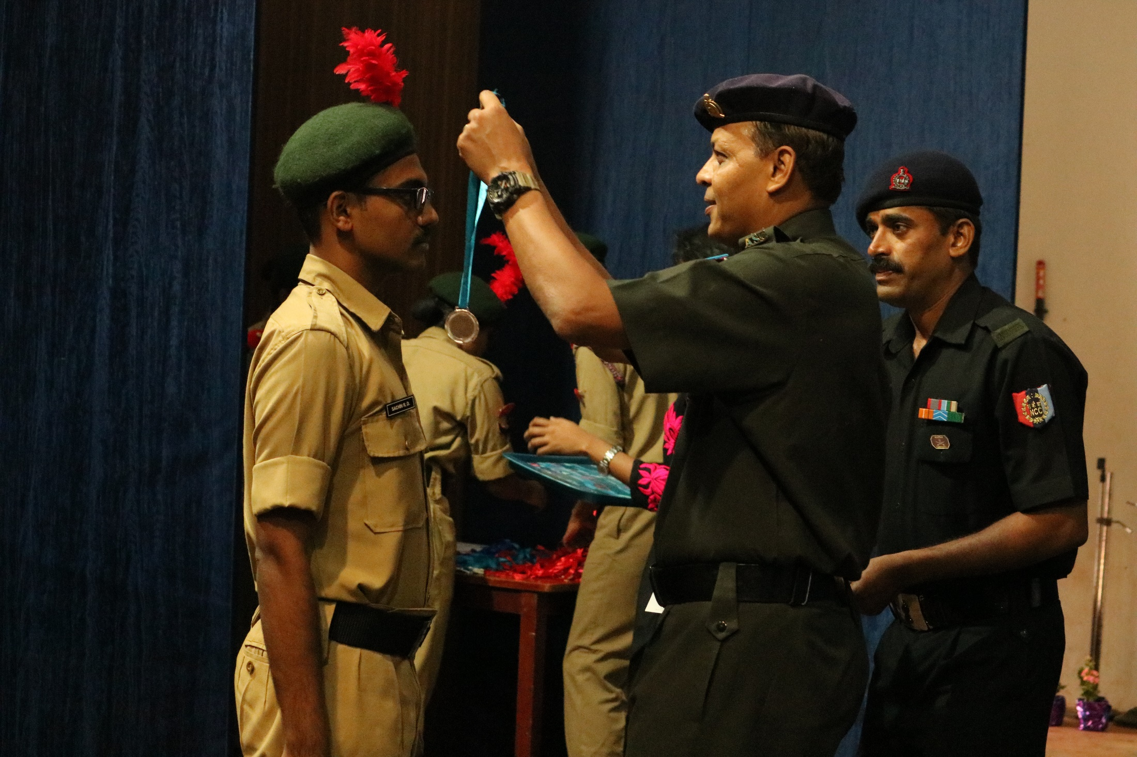

Slide 43
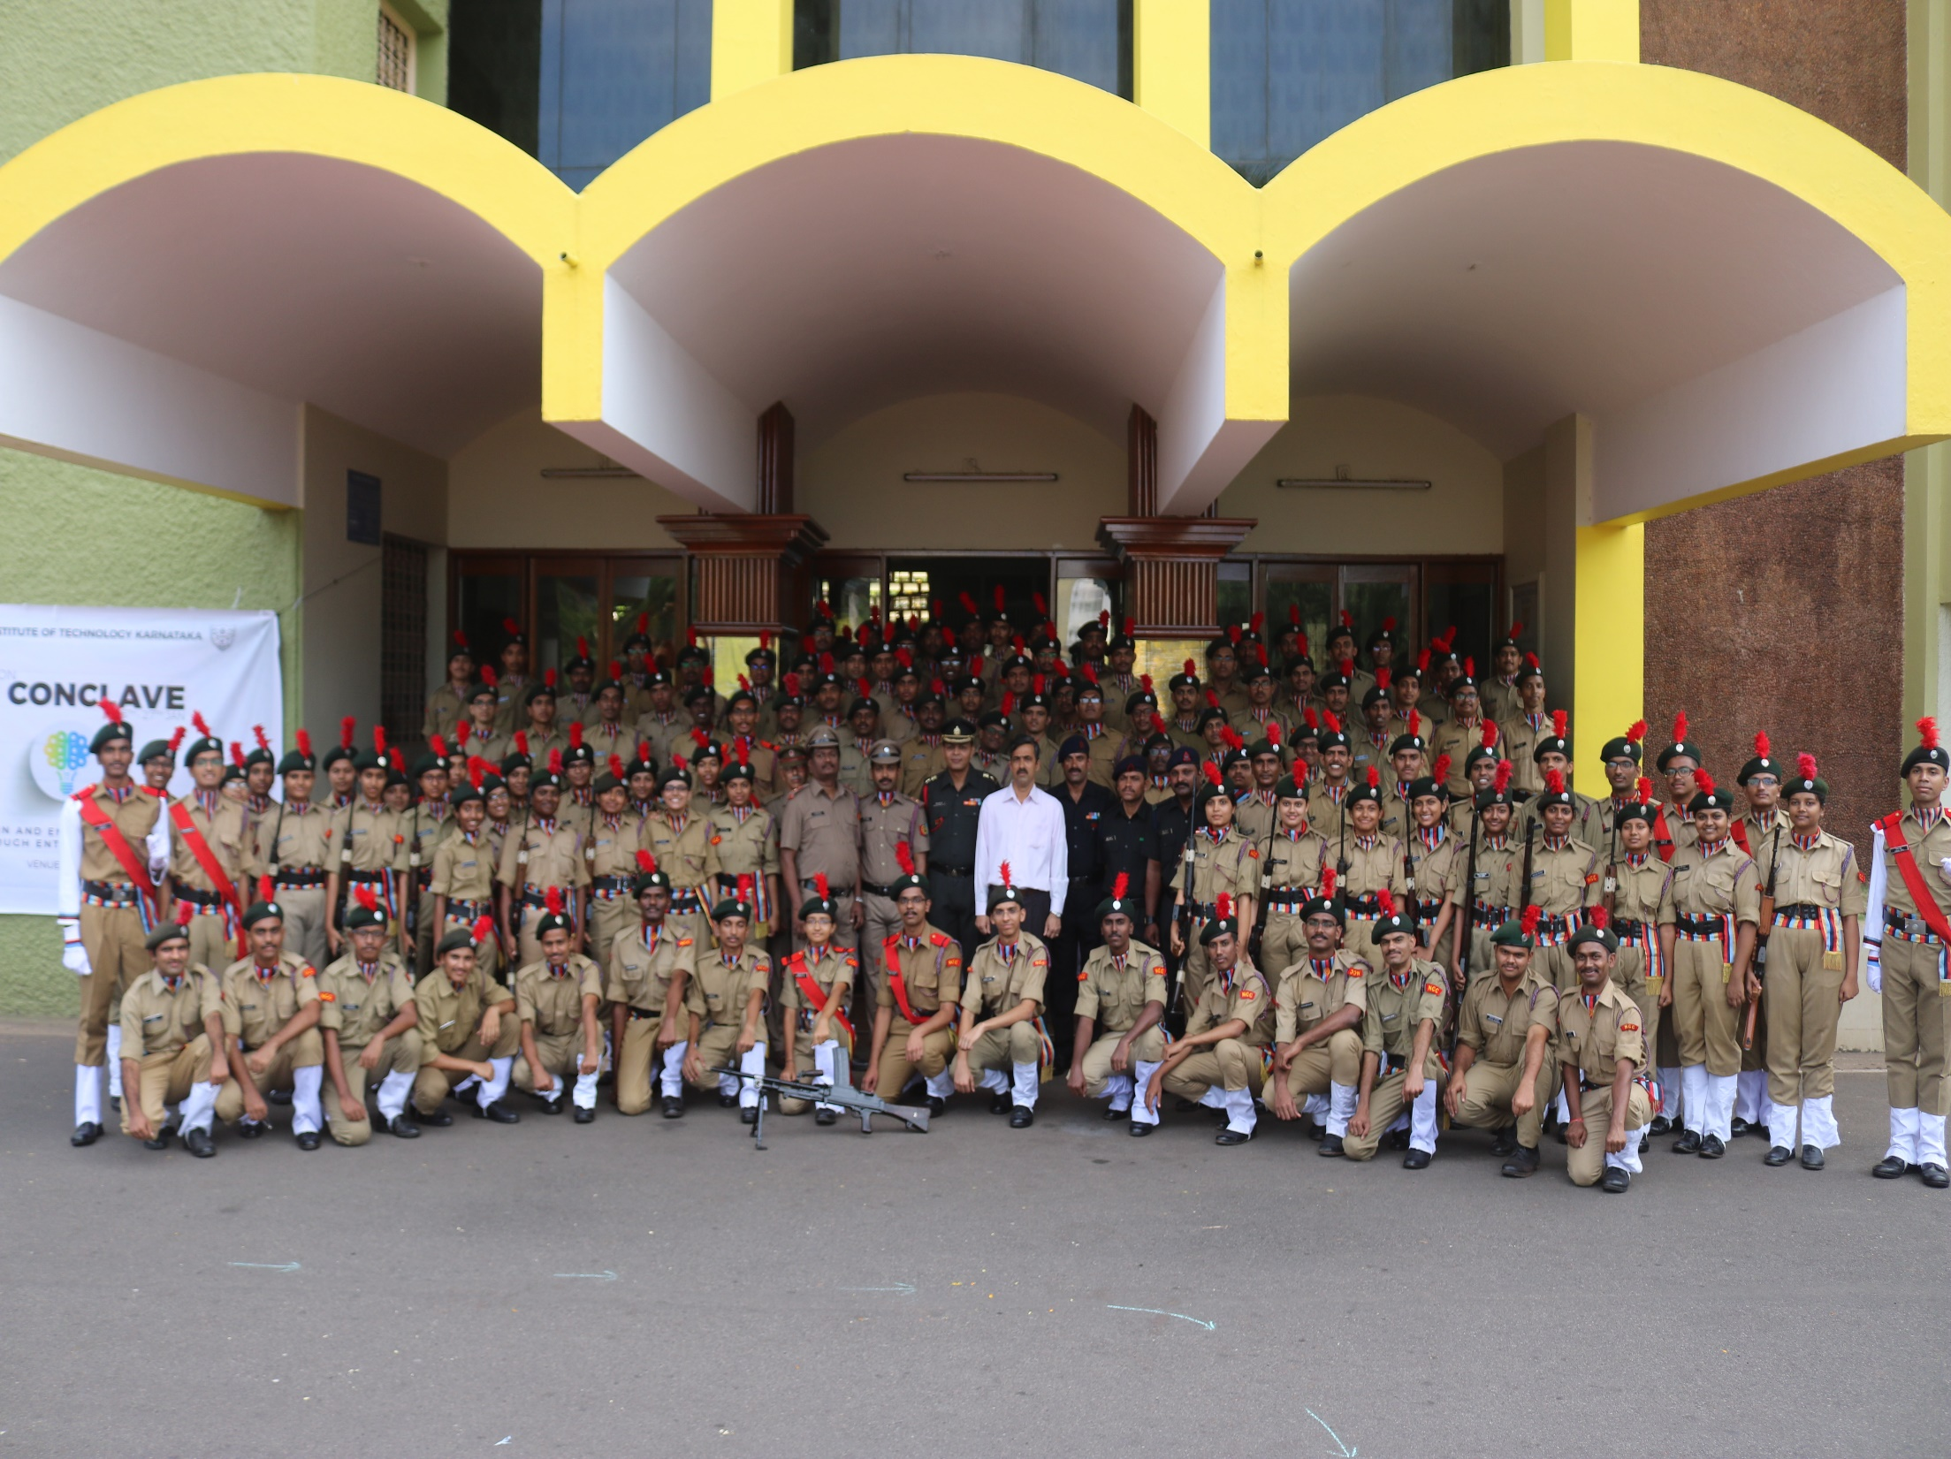


2 KAR ENGR COY NCC
2 KAR ENGR COY NCC

Slide 44
INDIAN DEFENCE FORCES AND
VARIOUS ENTRY SCHEMES

Slide 45



Slide 46
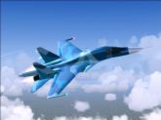
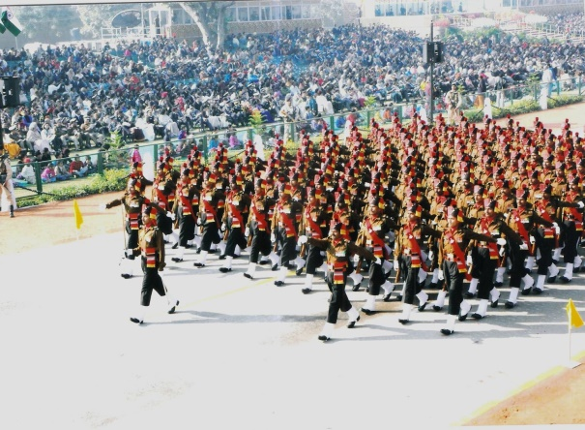
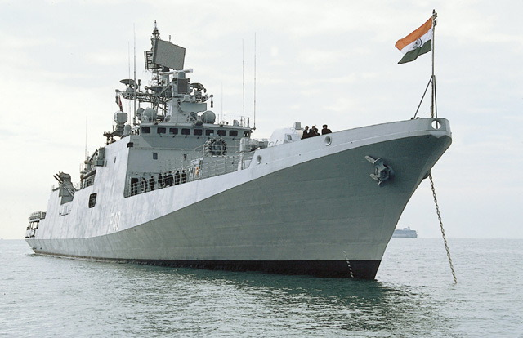
INDIAN DEFENCE FORCES

Slide 47

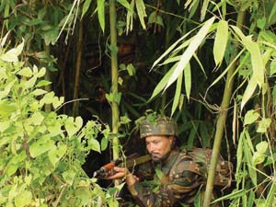
ARMY

Slide 48
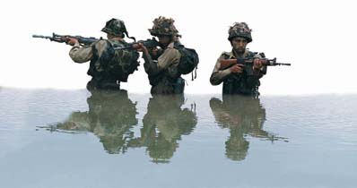

Slide 49
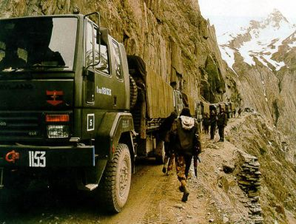

Slide 50
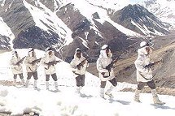
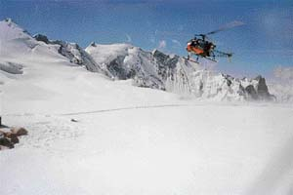
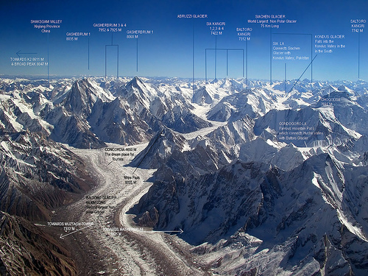

Slide 51
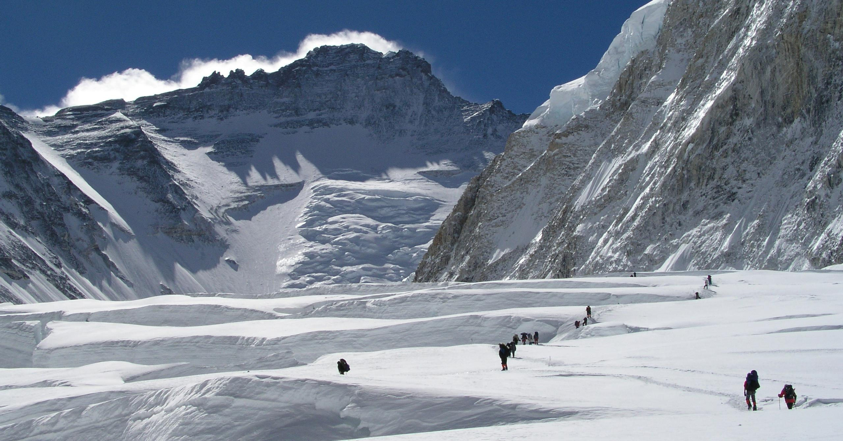

Slide 52
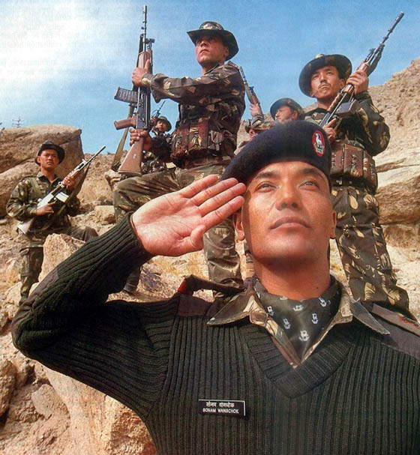

Slide 53
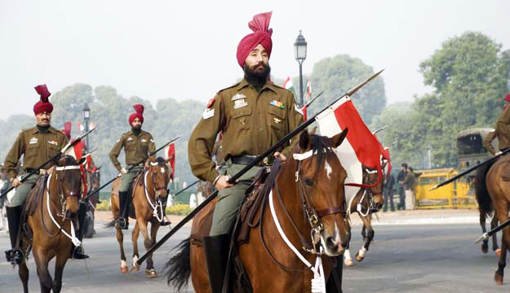

Slide 54
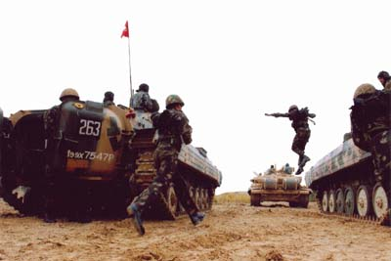

Slide 55
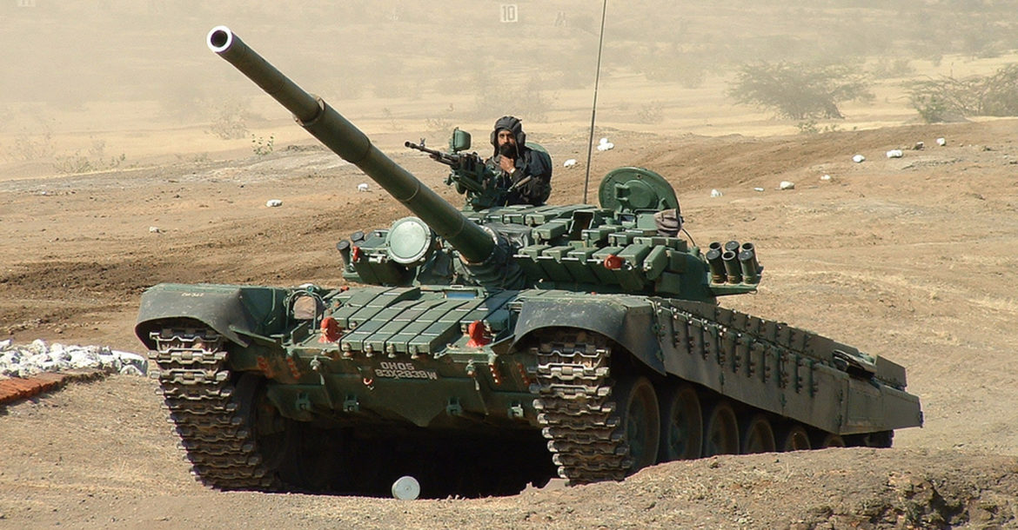

Slide 56
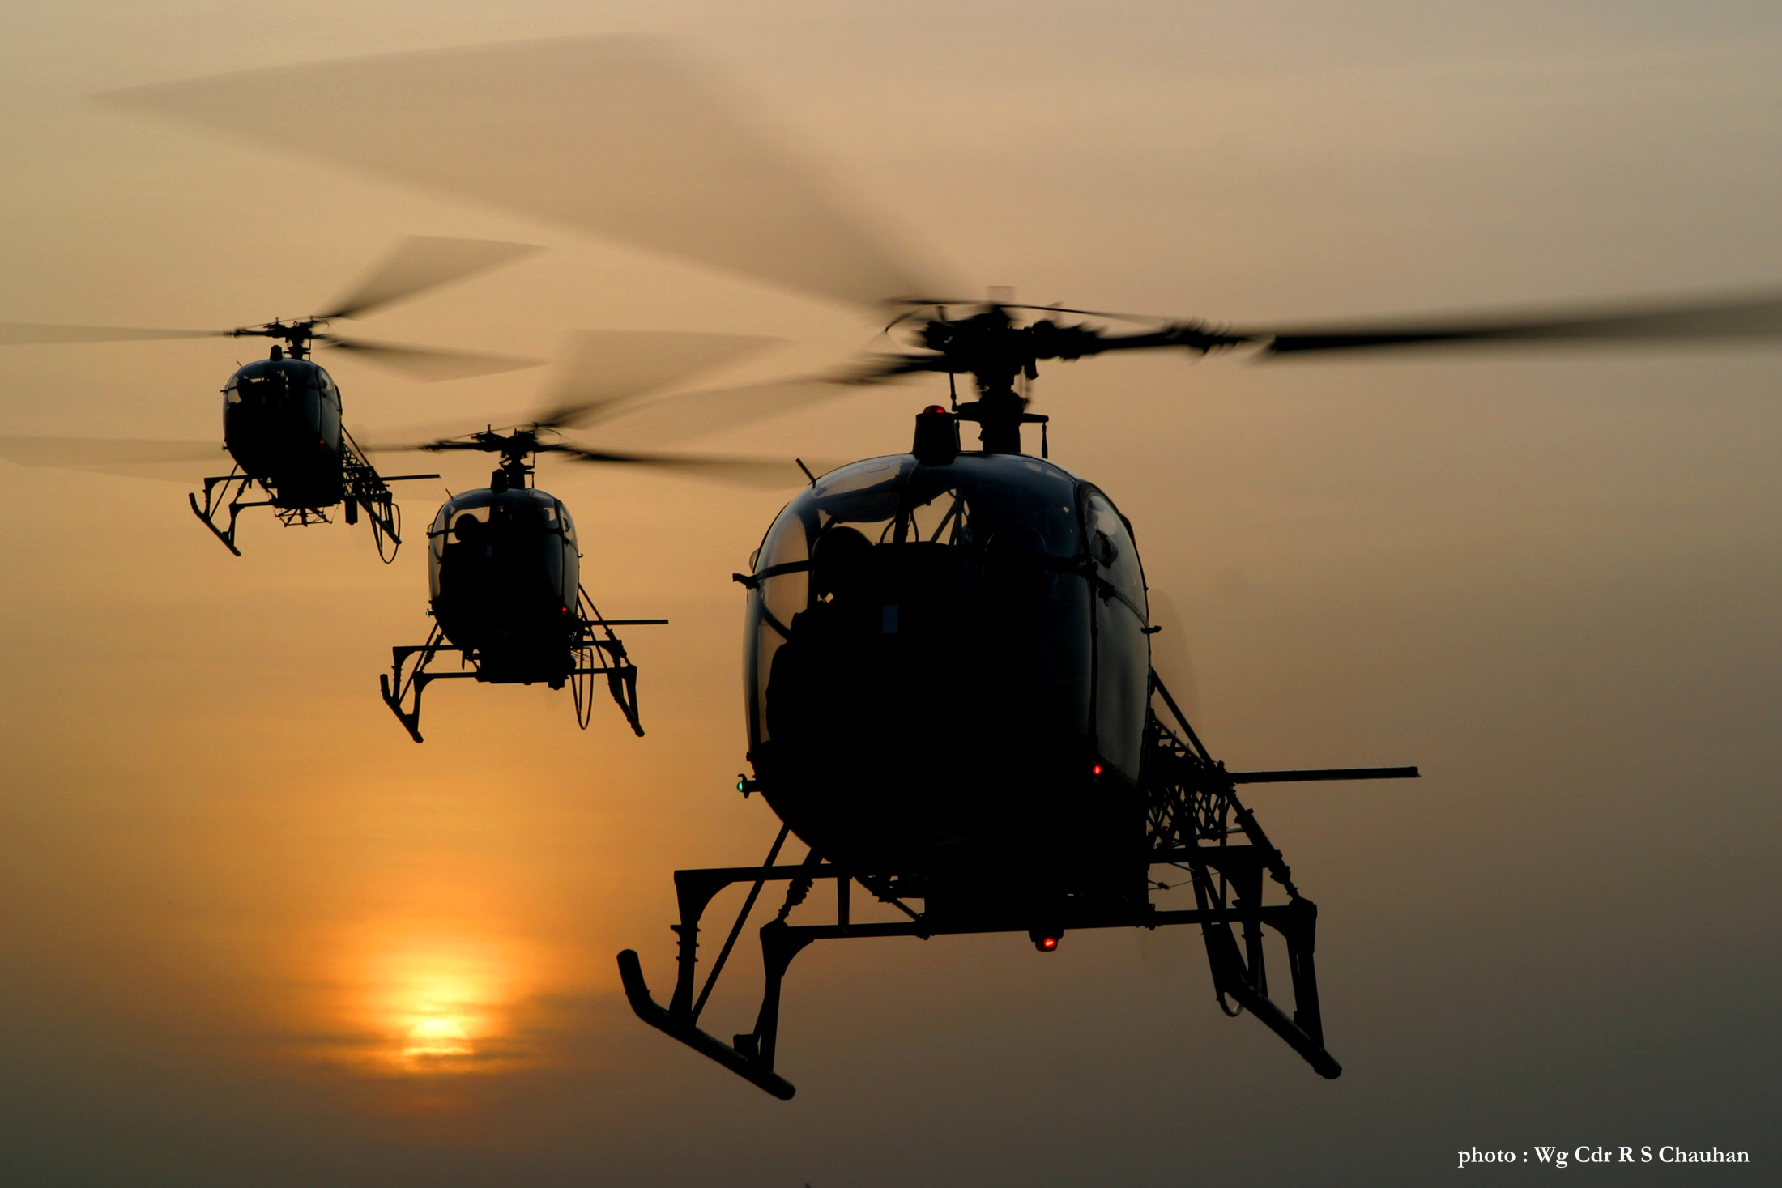

Slide 57


Slide 58


Slide 59


Slide 60


Slide 61


Slide 62


Slide 63


Slide 64


Slide 65


Slide 66


Slide 67


NAVY

Slide 68


Slide 69


Slide 70


Slide 72


Slide 73


Slide 74


Slide 75


Slide 76


Slide 77


Slide 78


AIR FORCE

Slide 79


Slide 80


Slide 81


Slide 82


Slide 83


Slide 84


Slide 85


Slide 86


Slide 87


Slide 88


Slide 89

THE CHALLENGE
LEADING MEN INTO BATTLE.
MOTIVATING MEN TO LAY DOWN THEIR LIVES.
MASTERING TECHNOLOGY.
DEFENDING THE MOST ADVANCING NATION IN THE WORLD.

Slide 90

WE PRIDE OURSELF ON …
OUR PATRIOTISM.
OUR DISCIPLINE.
OUR MILITARY MIGHT.
OUR ESPIRIT DE CORPS.
THE PEOPLES’ FAITH IN US.

Slide 91

OUR CONVICTION
WE EMBODY THE STRENGTH OF THE NATION.
WE FORGE THE COURAGE OF THE NATION.
WE DEFEND THE HONOUR OF THE NATION.
WE ARE THE GUARDIANS OF ITS PEOPLE.

Slide 92
OUR COMMITMENT TO THE YOUTH
WE WILL IMPART/ INSTIL
KNOWLEDGE AND AWARENESS.
MORAL COMMITMENT AND ETHOS.
INTEGRITY AND UPRIGHTNESS.
SOCIAL CONSCIENCE AND RESPONSIBILITY.
COMRADERY AND EQUALITY.
FAIRNESS AND JUSTICE.
DILIGENCE AND QUALITY.
PROSPERITY AND CONTENTMENT.
HOPE, FAITH, BELIEF AND COURAGE.

Slide 93
DO YOU HAVE THE COURAGE
TO NEVER COW DOWN BEFORE INSOLENT MIGHT ?

Slide 94
DO YOU HAVE THE MATURITY
TO AVOID CAUSING PAIN TO THOSE WHO HAVE FAITH IN US?

Slide 95
ARE YOU PROUD OF
NOT WHO OR WHAT YOU ARE, OR
EVEN WHAT YOU ARE CAPABLE OF DOING
BUT
OF WHAT YOU ACTUALLY AND PRACTICALLY DO?

Slide 96
DO OR DON’T YOU
REALISE EACH OTHERS WORTH
EVEN IF IT IS IN VARYING DEGREES OF INDIVIDUAL DIFFERENCES, AND
ACKNOWLEDGE IT WITH A SMILE OR A GREETING, IF NOT A SALUTE ?

Slide 97
DO YOU
HAVE THE COMPASSION AND PASSION FOR HELPING THE WEAK AND FIGHTING THE OPPRESSOR ?

Slide 98
OF SHARING A CUP OF TEA WITH THE COLD AND NEEDY,
GIVING A NOD OR GLANCE OF ENCOURAGEMENT TO THOSE STRUGGLING,
OR GIVING THEM EVEN A BIT OF YOUR MOST PRECIOUS POSSESSION –
YOUR TIME ?

Slide 99
ARE YOU
THE GIFT AND POWER OF DEMOCRACY
THE HIGHEST LEVEL OF HUMANITY ANY CIVILIZATION CAN REACH
GRATEFUL FOR THE GREATEST PRIVILEGE A SOCIETY CAN BESTOW ON ITS PEOPLE?

Slide 100
IF SO, EVEN WITHOUT A UNIFORM,
YOU ARE ALREADY A SOLDIER.
WAGE YOUR WARS ON THE DEMONS WITHIN YOU AND THE ONES IN THE IMMEDIATE VICINITY.

Slide 101
BUT MEANWHILE THE NATION NEEDS
ARMED FORCES
TO WAGE WARS ON ADVERSARIES
THAT THREATEN THE NATION FROM OUTSIDE AND WITHIN.

Slide 102
WE NEED
WARRIORS
AND
TECHNO-WARRIORS

Slide 103
ONCE AGAIN, THE CHALLENGE FOR YOU
LEADING MEN INTO BATTLE,
MOTIVATING MEN TO LAY DOWN THEIR LIVES,
MASTERING TECHNOLOGY
AND
DEFENDING THE MOST ADVANCING NATION IN THE WORLD

Slide 104
DO YOU HAVE IT IN YOU ?

Slide 105




THESE YOUNGSTERS HAD!
NOW
SUO NIRDESH KUMAR YADAV BATCH OF 2014
LT NIRDESH KUMAR YADAV CORPS OF ENGINEERS
NOW
L/ CPL SUDHIR CHANDRA HEGDE
BATCH OF 2014
SUB LT SUDHIR CHANDRA HEGDE
INDIAN NAVY

Slide 106



NOW
SGT PRASIDH NAIK
BATCH OF 2015
LT PRASIDH NAIK
NOW
CDT PANDEY
2016
LT AVINAH PANDEY

Slide 107


NOW
NCC CDT PRASHANTH J
2016
LT PRASHANTH J
NDA, KHADAKWASLA

Slide 108


NOW
NCC SUO SAMANVITA SHASTRY
BATCH OF 2018
SUB LT SAMANVITA SHASTRY
INA, EZHIMALA

Slide 109
ENTRY SCHEMES

Slide 110
INDIAN MILITARY ACADEMY
DIRECT ENTRY
COMMENCEMENT OF COURSE EACH YEAR | JANUARY AND JULY
AGE AT THE TIME OF JOINING | 19-24 YEARS
EDUCATIONAL QUALIFICATION | DEGREE/ EQUIVALENT AT THE TIME OF JOINING COURSE
MODE OF SELECTION | COMBINED DEFENCE EXAM (CDSE) UPSC AND SSB
HOW TO APPLY | ONLINE (www.joinindianarmy.com)

Slide 111
ENGINEERING GRADUATES (SSC TECHNICAL)
COMMENCEMENT OF COURSE EACH YEAR | DEC-JAN and JUN-JUL
AGE AT THE TIME OF JOINING | 20-27 YEARS
EDUCATIONAL QUALIFICATION | ENGINEERING DEGREE IN NOTIFIED DISCIPLINE
MODE OF SELECTION | DIRECT SSB INTERVIEW
HOW TO APPLY | ONLINE (www.joinindianarmy.com) (www.joinindiannavy.com)

Slide 112
UNIVERSITY ENTRY SCHEME
COMMENCEMENT OF COURSE EACH YEAR | JULY
AGE AT THE TIME OF JOINING | 19-25 YEARS (FINAL YEAR ENGINEERING STUDENTS ) 18-24 YEARS (PRE-FINAL YEAR ENGINEERING STUDENTS)
EDUCATIONAL QUALIFICATION | FINAL AND PRE-FINAL YEAR STUDENTS OF AN ENGINEERING DEGREE COURSE.
MODE OF SELECTION | CAMPUS INTERVIEW AND SSB INTERVIEW
HOW TO APPLY | ONLINE (www.joinindianarmy.com)

Slide 113
OFFICERS TRAINING ACADEMY
SHORT SERVICE COMMISSION
COMMENCEMENT OF COURSE | MAY AND OCT/NOV
AGE AT THE TIME OF JOINING | 19-24 YEARS
EDUCATIONAL QUALIFICATION | DEGREE OR EQUIVALENT AT THE TIME OF JOINING THE COURSE
MODE OF SELECTION | COMBINED DEFENCE EXAM (CDSE) UPSC AND SSB
HOW TO APPLY | ONLINE (www.joinindianarmy.com)

Slide 114
OFFICERS TRAINING ACADEMY
SHORT SERVICE COMMISSION (TECHNICAL)
MONTH OF COMMENCEMENT OF COURSE EACH YEAR | MAY AND OCT/NOV.
AGE AT THE TIME OF JOINING | 20-27 YEARS
EDUCATIONAL QUALIFICATION | ENGINEERING DEGREE IN NOTIFIED DISCIPLINE
MODE OF SELECTION | DIRECT SSB INTERVIEW
HOW TO APPLY | ONLINE (www.joinindianarmy.com)

Slide 115
OFFICERS TRAINING ACADEMY
SHORT SERVICE COMMISSION (NCC SPECIAL ENTRY SCHEME)
COMMENCEMENT OF COURSE | MAY
AGE AT THE TIME OF JOINING | 19-25 YEARS
EDUCATIONAL QUALIFICATION | GRADUATE WITH 50% AGGREGATE MARKS, TWO YEARS' SERVICE IN NCC SENIOR DIV. ARMY WITH MINIMUM 'B' GRADE IN 'C' CERTIFICATE EXAM
MODE OF SELECTION | DIRECT SSB INTERVIEW
HOW TO APPLY | ONLINE (www.joinindianarmy.com)

Slide 116

OFFICERS TRAINING ACADEMY
WOMEN'S SPECIAL ENTRY SCHEME (OFFICERS)
COMMENCEMENT OF COURSE | MARCH AND SEPTEMBER
AGE AT THE TIME OF JOINING | 19-27 YEARS
EDUCATIONAL QUALIFICATION | GRADUATE/ POST-GRADUATE/ENGINEERING GRADUATE.
MODE OF SELECTION | DIRECT SSB INTERVIEW
HOW TO APPLY | ONLINE (www.joinindianarmy.com)

Slide 117

TERRITORIAL ARMY (PART-TIME)
MONTH OF SELECTION PROCESS | JUNE- JULY DEC-JAN
AGE AT THE TIME OF JOINING | 18-42 YEARS
EDUCATIONAL QUALIFICATION | GRADUATION
MODE OF SELECTION | PIB EXAM AND SSB
HOW TO APPLY | ONLINE (www.joinindianarmy.com)

Slide 118

10+2 PCM (TECH)
COMMENCEMENT OF COURSE EACH YEAR | JANUARY AND JULY
AGE AT THE TIME OF JOINING | 16¹/₂-19¹/₂ years
EDUCATIONAL QUALIFICATION | 10+2 PASS WITH AGGREGATE.
MODE OF SELECTION | APPLY DIRECTLY TO RECRUITMENT DIRECTORATE
WHEN TO APPLY | MAY AND NOVEMBER.
HOW TO APPLY | ONLINE (www.joinindianarmy.com)

Slide 119

NATIONAL DEFENCE ACADEMY
MONTH OF COMMENCEMENT OF COURSE EACH YEAR | JANUARY AND JULY
AGE AT THE TIME OF JOINING | 16¹/₂-19 years
EDUCATIONAL QUALIFICATION | CLASS 12 OF THE 10+2 SYSTEM OF EDUCATION, OR EQUIVALENT
MODE OF SELECTION | NDA EXAM BY UPSC AND SSB INTERVIEW
HOW TO APPLY | ONLINE (www.joinindianarmy.com)

